Slide 1
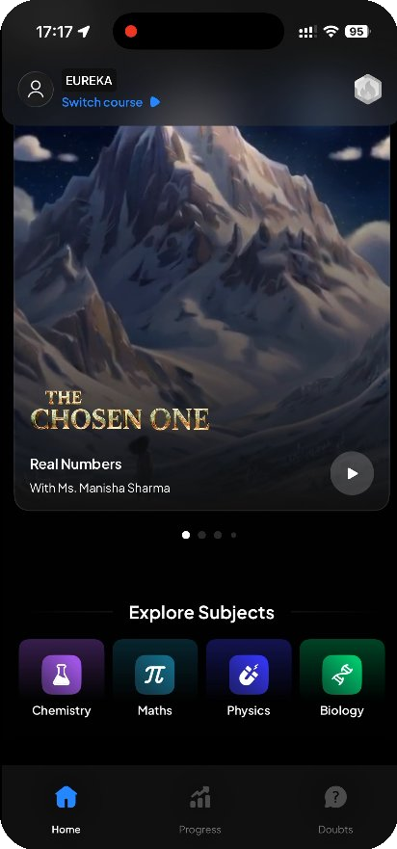
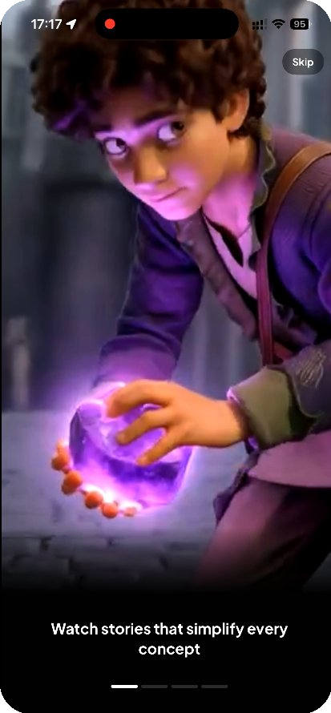
PRODUCT TEARDOWN
Eureka
by ALLEN
A Product Teardown
Moving from passive consumption to active mastery.
Prepared by Ashutosh Singh · Product Manager Intern Assignment

Slide 2
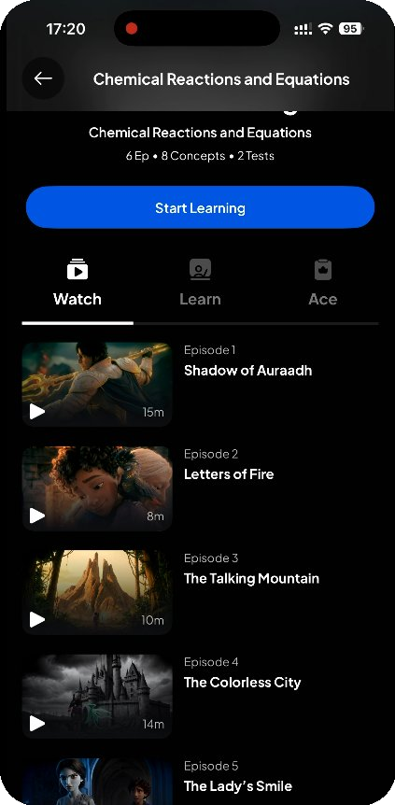



WHAT IS EUREKA?
Education disguised as entertainment.
Core value proposition
Replaces whiteboard lectures with episodic, high-fidelity 3D storytelling to teach core STEM concepts.
The target user
Class 10 students disengaged by textbooks — motivated by visual narratives and game mechanics.
The core loop
Watch
›
Learn
›
Ace
0:03
2:43

Slide 3
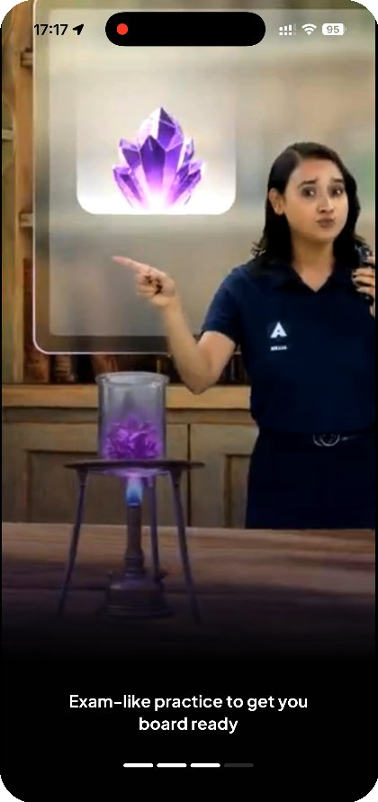

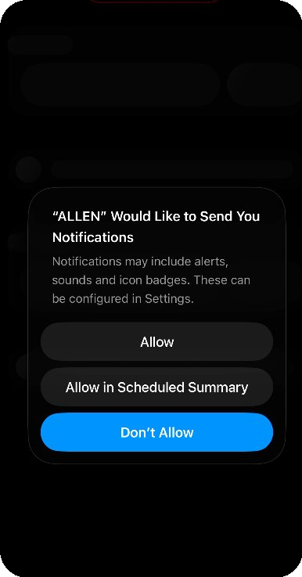


THE ONBOARDING
High production value, low contextual activation.
The good
The opening cinematic is visually stunning and instantly sets a premium tone.
The flaw
Immediately after, a generic “Allow Notifications” prompt appears — with zero context on why it matters.
The result
Users likely tap “Don’t Allow,” crippling the app’s single most important re-engagement lever.
0:08
0:11

Slide 4



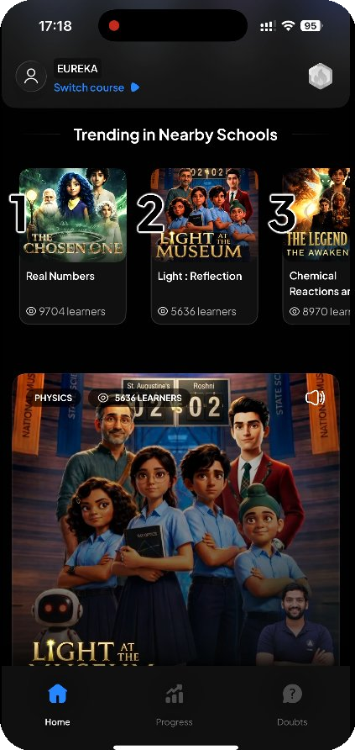
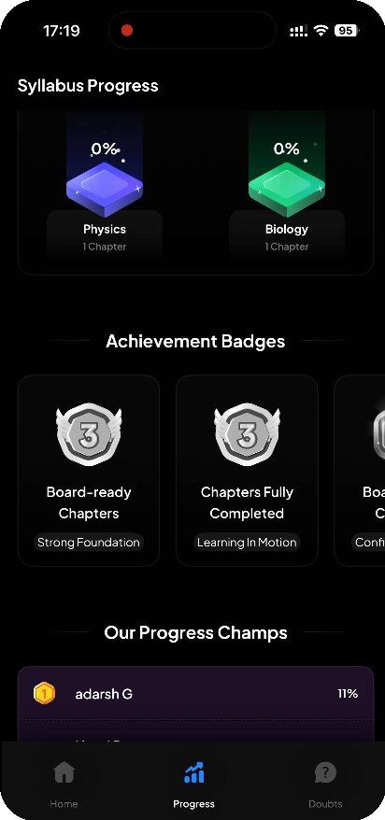
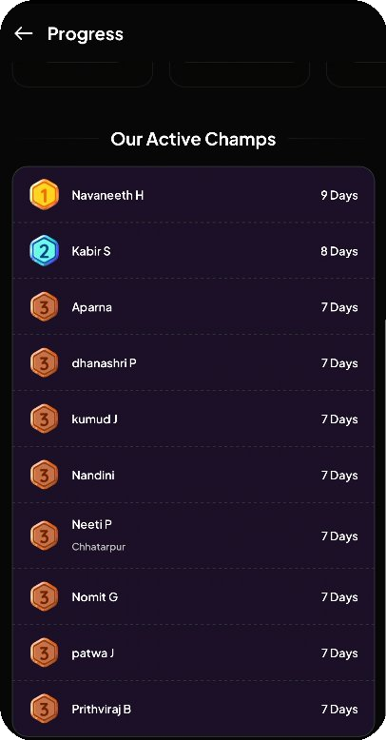
WHAT'S WORKING
Hooking users with streaks & stories.
Social proof
Gamification engine
Streaks & leaderboards
“Trending in Nearby Schools” is a sharp PLG tactic — it manufactures FOMO and local relevance.
Syllabus %, badges & streaks tap the dopamine loops this demo already knows (Duolingo, Snapchat).
“Active Champs” day-streaks turn study into a daily habit; episodes chunk daunting chapters.
1:05
1:52
5:02

Slide 5

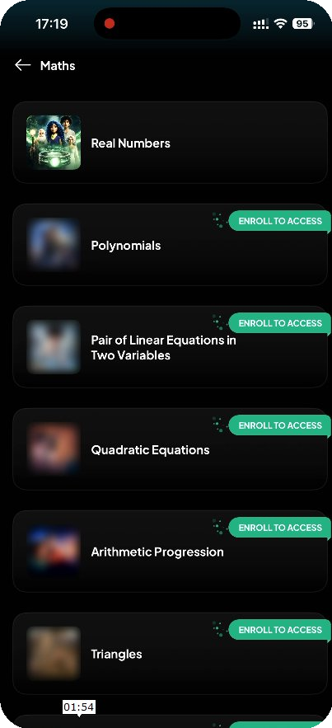



WHAT'S NOT WORKING
The “Netflix illusion” adds cognitive load.
Passive architecture — the UX mimics streaming: great for browsing movies, wrong for structured study. The student must guess what’s next.
Navigation friction — too many taps to reach practice: subject → chapter → enroll → “Ace” tab → launch test.
No “start here” — new users see an empty profile and 0% progress, but get no clear first-step call to action.
No in-context doubts — mid-lecture or mid-quiz there’s no way to ask a quick question. A floating AI button / corner-swipe should solve doubts without leaving the screen.
0:16
1:54

Slide 6
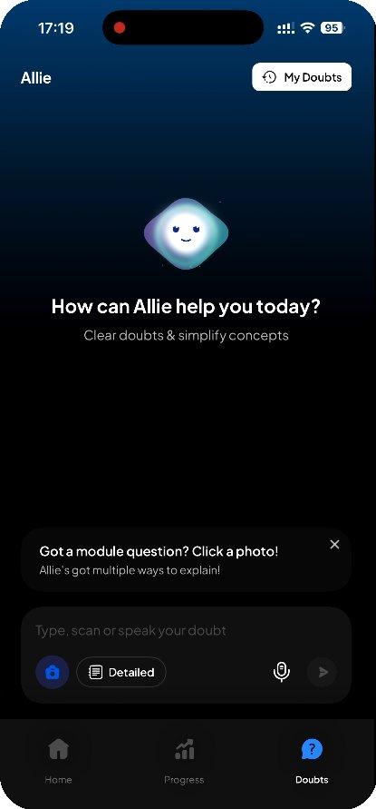




THE BIG OPPORTUNITY
Proactive AI: from browsing to guided missions.
The problem
PROPOSED
“Allie” is buried as a reactive tool — students open it only when they’re already stuck.
Today’s Mission
The fix
Watch Ep.1 — Chemical Reactions
Make Allie the proactive center of the app, not a help desk hidden in a tab.
Take a 5-question quiz
The flow
On first login Allie asks “What are you struggling with?” → auto-builds a Daily Mission on the home screen.
Review 2 flagged doubts
1 of 3 done
The impact
Cuts time-to-value, kills browsing fatigue, turns a passive video library into a personal AI tutor.

